Slide 1

SOCIONICS
All slides are copyrighted by Jack Oliver Aaron of the World Socionics Society
A CRASH COURSE

Slide 2
5. TYPES
Part I
All slides are copyrighted by Jack Oliver Aaron of the World Socionics Society

Slide 3
SO FAR
All slides are copyrighted by Jack Oliver Aaron of the World Socionics Society
Information Elements
Information Metabolism
Functions of Model A

Slide 4
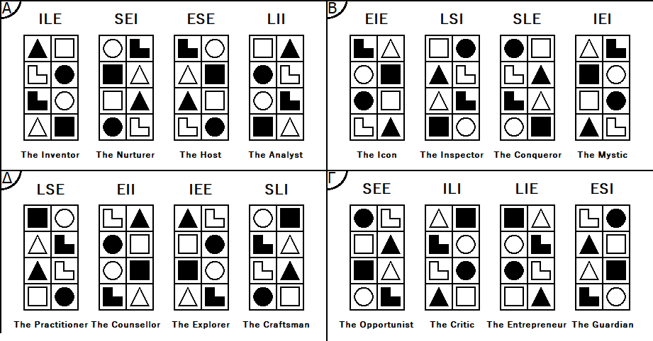
WHAT’S NEXT
All slides are copyrighted by Jack Oliver Aaron of the World Socionics Society
Information Elements
Information Metabolism
Functions
Types

Slide 5
TODAY
All slides are copyrighted by Jack Oliver Aaron of the World Socionics Society
8/15 Type Dichotomies
Temperaments
Clubs
Quadras

Slide 6
TYPES of
INFORMATION METABOLISM
(TIMs)
All slides are copyrighted by Jack Oliver Aaron of the World Socionics Society

Slide 7
WHAT IS A TIM?
All slides are copyrighted by Jack Oliver Aaron of the World Socionics Society
ILE - “The Innovator”
8 IM Elements assigned to 8 Functions
16 possible combinations, i.e. types.
A hierarchy of fluid intelligences
Also a hierarchy of motivations
The orientation of an individual to metabolising each kind of information
Determined by 15 Type Dichotomies
1 2
4 3
6 5
7 8

Slide 8
Type Names (Three Letters)
All slides are copyrighted by Jack Oliver Aaron of the World Socionics Society
Letter One
Can be Sensory, Logical, Intuitive or Ethical
Corresponds to the Leading function
Letter Two
Also can be Sensory, Logical, Intuitive or Ethical
Corresponds to the Creative function
Letter Three
Can be either Energiser or Integrator
E.g. ILE is Intuitive Logical Energiser

Slide 9
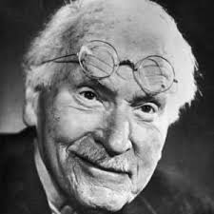
4x Jungian Dichotomies
All slides are copyrighted by Jack Oliver Aaron of the World Socionics Society
May already be familiar with these
Used by MBTI, but slightly different rules
Energiser vs. Integrator
Sensory vs. Intuitive
Logical vs. Ethical
Rational vs. Irrational

Slide 10

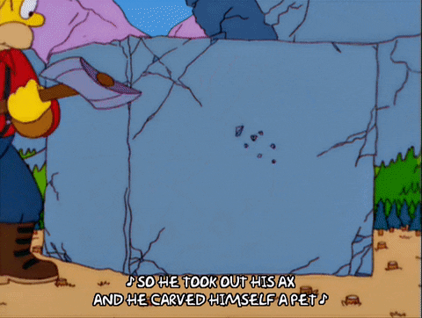
ENERGISER VS. INTEGRATOR
All slides are copyrighted by Jack Oliver Aaron of the World Socionics Society
Energiser | Integrator
Extroverted elements in Obvious functions Introverted elements in Subtle functions Breadth-oriented Energy directed towards increasing quantity Starts things up, gets things going More proactive Traditionally called “ExtraTIM” ILE, ESE, EIE, SLE, SEE, LIE, LSE, IEE Exxx | Introverted elements in Obvious functions Extroverted elements in Subtle functions Depth-oriented Energy directed towards refining quality Finishes things off, ties up loose ends More reactive Traditionally called “IntroTIM” SEI, LII, LSI, IEI, ILI, ESI, EII, SLI Ixxx

Slide 11
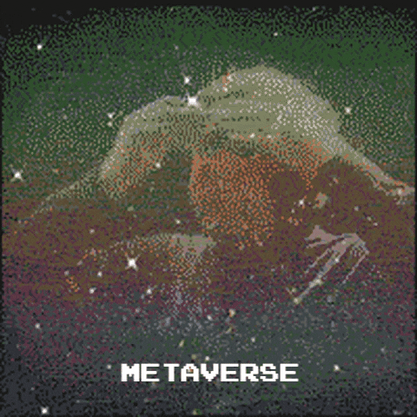


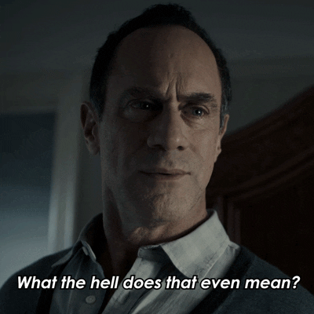
INTUITOR VS. SENSOR
All slides are copyrighted by Jack Oliver Aaron of the World Socionics Society
Intuitor | Sensor
Intuitive elements in Strong functions Sensory elements in Weak functions Confident exploring abstract ideas Easily notice and identify patterns Can lack confidence managing real things Can struggle to notice and identify details At home in their imagination ILE, LII, EIE, IEI, ILI, LIE, EII, IEE xNxx | Sensory elements in Strong functions Intuitive elements in Weak function Confident managing real things Easily notice and identify details Can lack confidence exploring abstract ideas Can struggle to notice and identify patterns At home in the present moment SEI, ESE, LSI, SLE, SEE, ESI, LSE, SLI xSxx

Slide 12
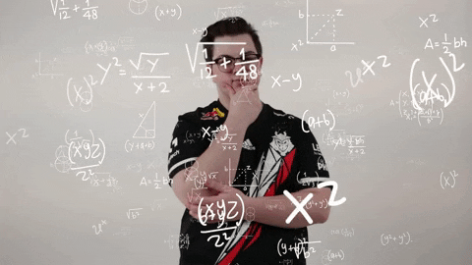

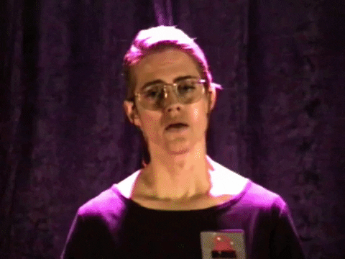

LOGICIAN VS. ETHICIST
All slides are copyrighted by Jack Oliver Aaron of the World Socionics Society
Logician | Ethicist
Logical elements in Strong functions Ethical elements in Weak functions Confident reasoning with facts and logic Easily makes sense of things Can lack confidence with emotions Can struggle to read people’s intentions At home problem-solving Called “Thinking” in MBTI/Jung’s works ILE, LII, SLE, LSI, ILI, LIE, LSE, SLI xxTx | Ethical elements in Strong functions Logical elements in Weak functions Confident assessing feelings and emotions Easily reads people’s intentions Can lack confidence with logic and facts Can struggle to make sense of things At home connecting with people Called “Feeling” in MBTI/Jung’s works SEI, ESE, EIE, IEI, SEE, ESI, EII, IEE xxFx

Slide 13
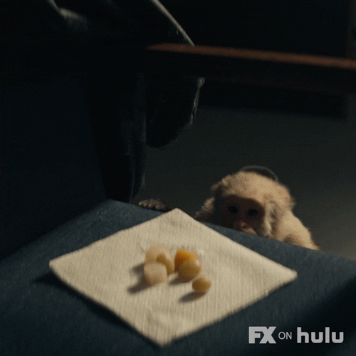
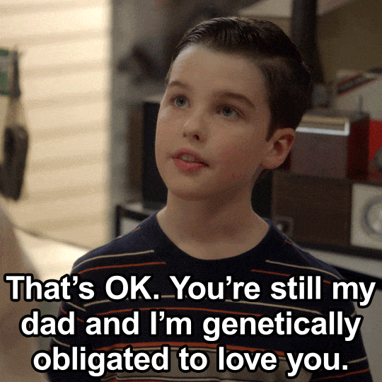
IRRATIONAL VS. RATIONAL
All slides are copyrighted by Jack Oliver Aaron of the World Socionics Society
Irrational | Rational
Perceptions in Demanding functions Judgements in Supplying functions Motivated by interests and instincts Obligations used to justify desires NOT the same as MBTI ‘Perceiving’ ILE, SEI, SLE, IEI, SEE, ILI, IEE, SLI xxxP | Judgements in Demanding functions Perceptions in Supplying functions Motivated by acknowledged obligations Desires used to support obligations NOT the same as MBTI ‘Judging’ ESE, LII, EIE, LSI, LIE, ESI, LSE, EII xxxP

Slide 14
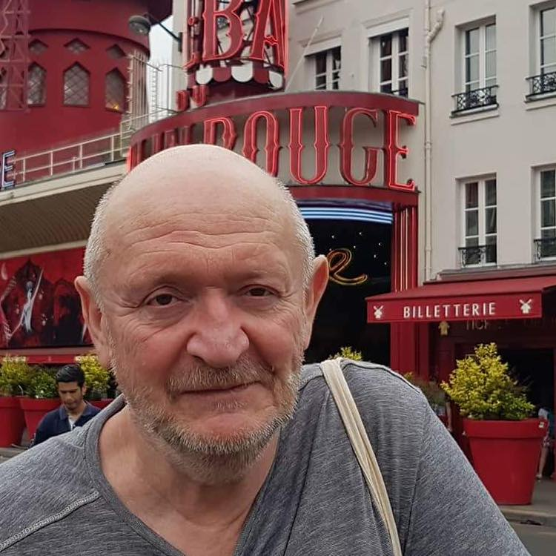
Reinin Dichotomies
All slides are copyrighted by Jack Oliver Aaron of the World Socionics Society
Grigoriy Reinin came up with more dichotomies
16 types, so 15 dichotomies needed.
4 Jungian dichotomies
11 Reinin dichotomies

Slide 15
TYPE DICHOTOMIES
All slides are copyrighted by Jack Oliver Aaron of the World Socionics Society
Energiser vs. Integrator
Sensor vs. Intuitor
Logician vs. Ethicist
Rational vs. Irrational
Reductionist vs. Holist
Identifier vs. Transformer
?
?
?
?
?
?
?
?
?

Slide 16
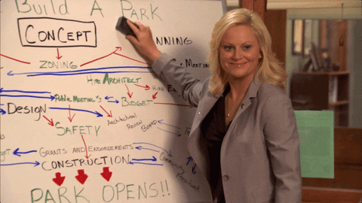

REDUCTIONIST VS. HOLIST
All slides are copyrighted by Jack Oliver Aaron of the World Socionics Society
Reductionist | Holist
Static elements in Public functions Dynamic elements in Private functions See separate pieces Describe each of the different parts Fixate on or switches states of being Traditionally called ‘Static’ ILE, LII, LSI, SLE, SEE, ESI, EII, IEE | Dynamic elements in Public functions Static elements in Private functions See everything together Describe the overall picture Transition in and out of ways of being Traditionally called ‘Dynamic’ SEI, ESE, EIE, IEI, ILI, LIE, LSE, SLI

Slide 17

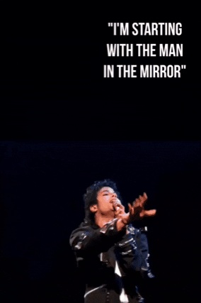
IDENTIFIER VS. TRANSFORMER
All slides are copyrighted by Jack Oliver Aaron of the World Socionics Society
Identifier | Transformer
Block Sensation+Ethics / Intuition+Logic Tend to Involve or Detach Look to Attract or Repulse Seeks the ‘right’ relationship with existence Dispute how distant/close we should be Harmonise the universe or stay independent Traditionally called ‘Democratic’ ILE, SEI, ESE, LII, SEE, ILI, LIE, ESI | Blocks Sensation+Logic / Intuition+Ethics Tend to Externalise or Internalise Look to Conclude or Question Seek the ‘right’ locus of change Dispute how certain/humble we should be Change the universe or develop oneself Traditionally called ‘Aristocratic’ EIE, LSI, SLE, IEI, LSE, EII, IEE, SLI

Slide 18
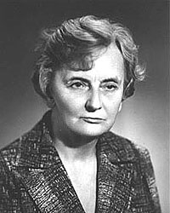
First Small Group: CLUBS
All slides are copyrighted by Jack Oliver Aaron of the World Socionics Society
Grouped by being:
Sensory or Intuitive
Logical or Ethical
Identifying or Transforming
Share the following functions:
Strong & Weak
Succeed or fail in same areas
Tend to have similar careers and hobbies

Slide 19
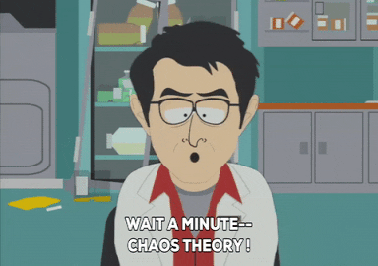
Intellectuals
All slides are copyrighted by Jack Oliver Aaron of the World Socionics Society
Intuitive & Logical Identifiers
Doubly-detached, removed from experiences
Best at abstract thinking
Lose touch with daily social interactions
Natural theorists, strategists, and inventors
ILE, LII, ILI & LIE

Slide 20

Socialites
All slides are copyrighted by Jack Oliver Aaron of the World Socionics Society
Sensory & Ethical Identifiers
Doubly-involved, tangled up in experiences
Best at daily social interactions
Get too involved and struggle to think things out
Natural carers, aesthetes, and diplomats
SEI, ESE, SEE & ESI

Slide 21
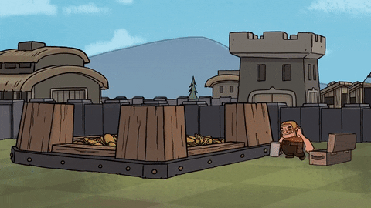
Realists
All slides are copyrighted by Jack Oliver Aaron of the World Socionics Society
Sensory & Logical Transformers
Doubly-external, grounded in reality
Best at real, practical thinking
Lack awareness of what is meaningful or sublime
Natural skilled labourers, technicians and soldiers
LSI, SLE, LSE & SLI

Slide 22

Humanitarians
All slides are copyrighted by Jack Oliver Aaron of the World Socionics Society
Intuitive & Ethical Transformers
Doubly-internal, steeped in inner meaning
Best at spiritual reflection, insight into humanity
Struggle to make things work in real life
Natural creatives, psychologists and clerics
EIE, IEI, EII & IEE

Slide 23
Second Small Group: TEMPERAMENTS
All slides are copyrighted by Jack Oliver Aaron of the World Socionics Society
Grouped by being:
Energising or Integrating
Rational or Irrational
Static or Dynamic
Share the following functions:
Obvious & Subtle
Demanding & Supplying
Public & Private
Have a similar pace, approach and energy

Slide 24
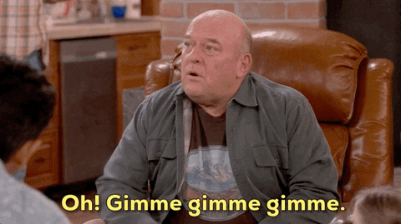
EP - Acquisitive
All slides are copyrighted by Jack Oliver Aaron of the World Socionics Society
Irrational & Reductionist Energisers
Accumulative in their desires
Rapidly switch between their desires
Exciting but can be hardest to predict
Tend to resist being tied down
ILE, SLE, SEE & IEE

Slide 25

IJ - Normative
All slides are copyrighted by Jack Oliver Aaron of the World Socionics Society
Rational & Reductionist Integrators
Selective in their obligations
Hold firmly to a few, set obligations
Resolute, but can be a stick in the mud
Tend to resist changes in circumstances
LII, LSI, ESI & EII

Slide 26
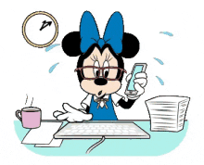
EJ - Obliging
All slides are copyrighted by Jack Oliver Aaron of the World Socionics Society
Rational & Holist Energisers
Accumulative in their obligations
Continuously adapt obligations to the situation
Highly active, but may never seem to stop
Tend to resist losing momentum
ESE, EIE, LIE & LSE

Slide 27

IP - Aligning
All slides are copyrighted by Jack Oliver Aaron of the World Socionics Society
Irrational & Holist Integrators
Selective in their desires
Gradually refine and perfect their desires
Adaptive but may lack presence or energy
Tend to resist being obligated to do more
SEI, IEI, ILI & SLI

Slide 28
TYPE DICHOTOMIES
All slides are copyrighted by Jack Oliver Aaron of the World Socionics Society
Energiser vs. Integrator
Sensor vs. Intuitor
Logician vs. Ethicist
Rational vs. Irrational
Reductionist vs. Holist
Identifier vs. Transformer
Accepter vs. Rejecter
Clarifier vs. Integrifier
?
?
?
?
?
?
?

Slide 29

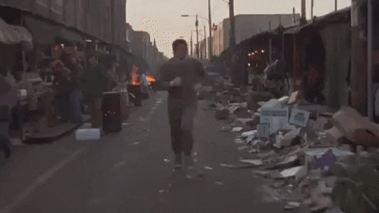
ACCEPTER VS. REJECTER
All slides are copyrighted by Jack Oliver Aaron of the World Socionics Society
Accepter | Rejecter
Appreciating elements in Valued functions Repudiating elements in Neglected functions Values openness and being down-to-earth Disposed towards keeping the peace Tends to explore and appreciate the world Prefers to discuss and reach a consensus Traditionally called ‘Judicious’ ILE, SEI, ESE, LII, LSE, EII, IEE, SLI | Repudiating elements in Valued functions Appreciating elements in Neglected functions Values strength of will and having a purpose Disposed towards confronting issues Tends to leave a mark upon the world Prefers wills to clash without compromise Traditionally called ‘Decisive’ EIE, LSI, SLE, IEI, SEE, ILI, LIE, ESI

Slide 30
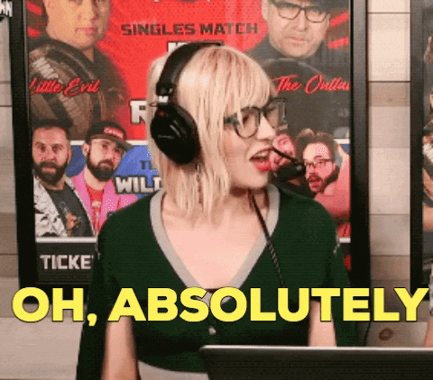
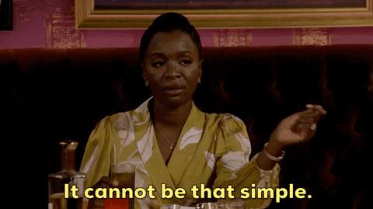
CLARIFIER VS. INTEGRIFIER
All slides are copyrighted by Jack Oliver Aaron of the World Socionics Society
Clarifier | Integrifier
Resolving elements in Valued functions Differentiating elements in Neglected functions Values personality and clear principles Disposed towards circles and groups Solves problems with guiding philosophy Prefers enthusiastic communication Considers the signal, leaves out noise Traditionally called ‘Merry’ ILE, SEI, ESE, LII, EIE, LSI, SLE, IEI | Differentiating elements in Valued functions Resolving elements in Neglected functions Values character and competence Disposed towards one-to-one relationships Solves problems on case-by-case basis Prefers matter-of-fact communication Keeps the noise at the expense of signal Traditionally called ‘Serious’ SEE, ILI, LIE, ESI, LSE, EII, IEE, SLI
Notes:
Example of Integrity-Seeking from Richard Feynman: https://www.youtube.com/watch?v=36GT2zI8lVA

Slide 31
Small Group Three: QUADRAS
All slides are copyrighted by Jack Oliver Aaron of the World Socionics Society
Grouped by being:
Accepter or Rejecter
Clarifier or Integrifier
Identifier or Transformer
Share the following functions:
Valued & Neglected
Appreciate or disregard the same things
Tend to get along better

Slide 32
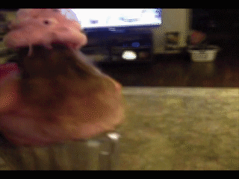
Α - Alpha - The Quadra of Infancy
All slides are copyrighted by Jack Oliver Aaron of the World Socionics Society
Accepting & Clarifying Identifiers
Attractive elements in Valued functions
Motivation: to discover the universe and unite it in harmony
Likes: fun, curiosity, discovery, beauty, comfort, guiding philosophies
Dislikes: negativity, judgmentalness, arrogance, discord
Intellectuals create and explore theories to explain the universe
Socialites help everyone to get along and have fun
Energisers push enthusiasm and interest in sharing new ideas
Integrators push aesthetic beauty and structural elegance
ILE, SEI, ESE & LII
Notes:
ALPHA SONG: https://www.youtube.com/watch?v=BAoCYwefq1A

Slide 33
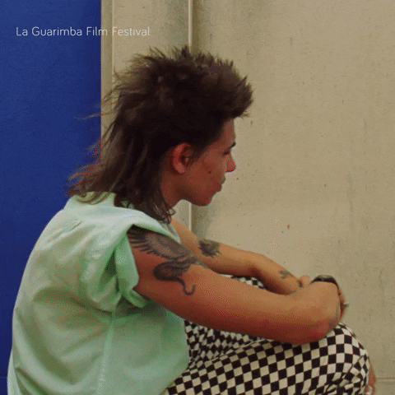
Β - Beta - The Quadra of Youth
All slides are copyrighted by Jack Oliver Aaron of the World Socionics Society
Rejecting & Clarifying Transformers
Conclusive elements in Valued functions
Motivation: to impactfully and meaningfully change the universe
Likes: passion, power, decisiveness, destiny, certainty, codes of honour
Dislikes: equivocation, hypocrisy, banality, quiet disapproval
Humanitarians express their vision to inspire and uplift society
Realists fight to win and enforce systems of law and order on society
Energisers push a will to power and amplification of their voice
Integrators push an uncompromising worldview and higher purpose
EIE, LSI, SLE & IEI
Notes:
BETA SONG: https://www.youtube.com/watch?v=T1gvNaC17B4

Slide 34

Γ - Gamma - The Quadra of Maturity
All slides are copyrighted by Jack Oliver Aaron of the World Socionics Society
Rejecting & Integrifying Identifiers
Repulsive elements in Valued functions
Motivation: to resist a dangerous world and achieve independence from it
Likes: loyalty, initiative, scepticism, competence, prudence, discernment
Dislikes: unreliability, complacency, laziness, sheep mentality
Socialites size people up, building and protecting relationships
Intellectuals assess long term trends to plan working strategies
Energisers push acquiring knowledge to overcome obstacles to success
Integrators push caution and criticism in trusting people and ideas
SEE, ILI, LIE & ESI
Notes:
GAMMA SONG: https://www.youtube.com/watch?v=6dYWe1c3OyU

Slide 35
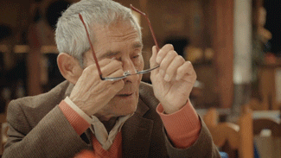
Δ - Delta - The Quadra of Seniority
All slides are copyrighted by Jack Oliver Aaron of the World Socionics Society
Accepting & Integrifying Transformers
Questioning elements in Valued Functions
Motivation: to grow and develop themselves, unlocking inner potential
Likes: sincerity, earnestness, practicality, desire to understand others
Dislikes: superficiality, drama, narrowness, neglect
Realists tinker with processes to increase quality of self-sufficient work
Humanitarians explore people’s perspectives to see the best in others
Energisers push a curiosity to keep learning and improving
Integrators push down-to-earth sincerity and harmonising of relationships
LSE, EII, IEE & SLI
Notes:
DELTA SONG: https://www.youtube.com/watch?v=g0LJNEQz-E4

Slide 36
EXERCISE TIME
All slides are copyrighted by Jack Oliver Aaron of the World Socionics Society
Try to determine the following for each of you:
Your Club
Your Temperament
Your Quadra

Slide 37
NEXT TIME
All slides are copyrighted by Jack Oliver Aaron of the World Socionics Society
Energiser vs. Integrator
Sensory vs. Intuitive
Logical vs. Ethical
Rational vs. Irrational
Reductionist vs. Holist
Identifier vs. Transformer
Accepter vs. Rejecter
Clarifier vs. Integrifier
Determined vs. Exacting
Contrarian vs. Obstinate
Affirmer vs. Denier
Space-Locked vs. Time-Locked
Sight-Locked vs. Speech-Locked
Thetic vs. Antithetic
Clockwise vs. Anticlockwise

Slide 38
Any Questions?
All slides are copyrighted by Jack Oliver Aaron of the World Socionics Society
Email Jack at worldsocionics@hotmail.com

